Slide 1
MOUNTADAPT
Empirical evidence of the influence of heatwaves on non-communicable diseases
20.02.2025, Open Training Session
Prasanta Kumar Roy
Lea Bernhardt

Slide 2
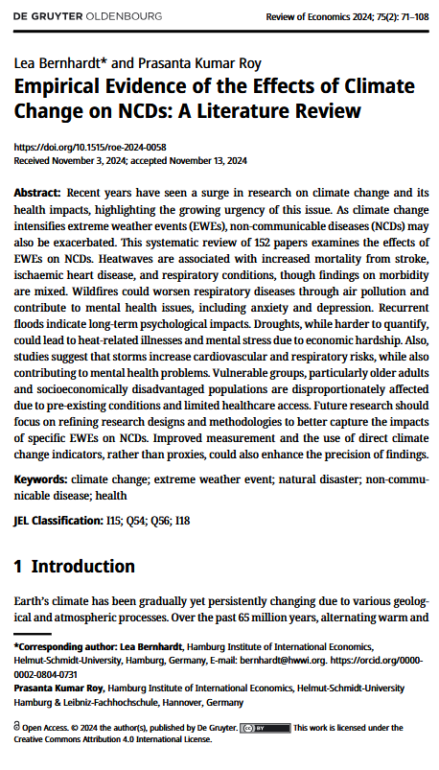
Literature review
Research Question: Global effects of climate change on NCDs ?
Studies: Web of Science, PubMed, Scopus (n = 2994)
Method: PRISMA (n = 152)
Literature on heat: n = 37, mortality and morbidity related to NCDs
Findings summary:
YoY studies increasing
Heatwaves most studied
Heterogenous definitions
Developing and hot regions
Europe less studied (except Spain)
Mountainous and colder regions less studied
Significant increase in morbidity (respiratory, cardiovascular)
Inconclusive results for mental-health
Confounded EWEs, NCDs (heat wildfire smoke respiratory)

Slide 3
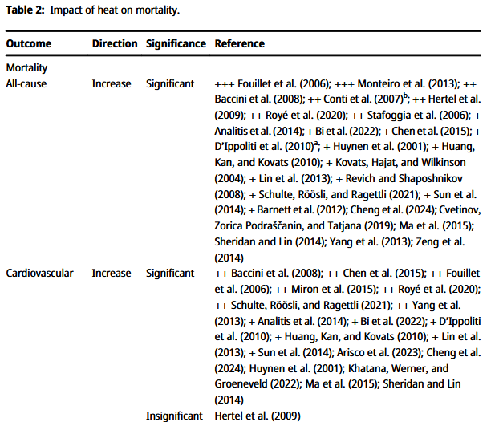
Findings: Mortality
Heat leads to a significant increase in
All-cause mortality
Fouillet et al. (2006): Heatwave in France August 1st – 20th 2003: cumulative excess mortality of 14729 deaths or 55%
Chen et al. (2015): Heatwaves in Nanjing between 2007-2013: increase in total mortality of 24.6%
Cardiovascular mortality
Fouillet et al. (2206): 3004 excess deaths because of circulatory system diseases
Chen et al. (2015): Increase in cardiovascular mortality of 46.9 %
Notes:
Note to Chen et al. : they examined 15 different heatwaves between 2007-2013: the results refer to the 11th Heatwave, paper does not specify when that exact heatwave took place
Chen et al.:
evaluate the differences in daily mortality during heat-wave days (defined using 15 HWs) compared with non-heat-wave days in Nanjing, during 2007 to 2013
HW11 definition: Heat waves defined as ≥4 consecutive days with daily average temperature >98th percentile had the best model fit
Study including all permanent residents living in the city (population: 8 million by the end of 2010)
Fouillet et al.:
From August 1st to 20th, 2003, the mean maximum temperature in France exceeded the seasonal norm by 11–12C on nine consecutive days
major increase in mortality was then observed
number of deaths observed from August to November 2003 in France was compared to those expected on the basis of the mortality rates observed from 2000 to 2002 and the 2003 population estimates
Unfortunately, they only provide percentage values for the all-cause mortality
Study conducted in all 22 regions of France

Slide 4
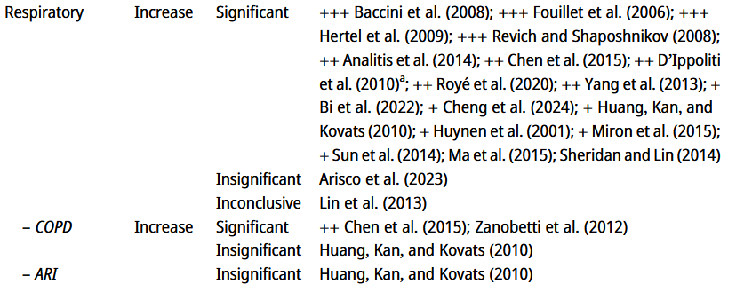
Findings: Mortality (continued)
Heat leads to a significant increase in
Cerebrovascular mortality
Neoplasm mortality
Respiratory mortality
Fouillet et al. (2006): 1365 excess deaths due to respiratory system diseases
Chen et al. (2015): 32% increase in respiratory mortality
However, some studies report inconclusive or insignificant results for these outcomes
Huang et al. (2010): 2003 heatwave in nine urban districts of Shanghai (6.3 million residents):
no significant increase in acute respiratory infection mortality

Slide 5
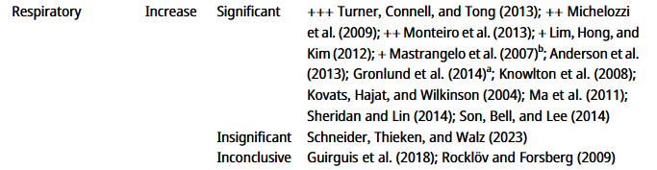
Findings Morbidity
Heat leads to a significant increase in
All-cause morbidity Turner, Connell and Tong (2013): ambulance attendances in Brisbane between 2000-2007: Main temperature effect for total morbidity: 50.6% Added heatwave effect for total morbidity: 18.8%
Cardiovascular morbidity Added heatwave effect for cardiovascular morbidity: 29.5%
Respiratory morbidity Main effects: 101.1% Added heatwave effect for respiratory morbidity: 48.7%
However, some studies report inconclusive or insignificant results or even a decrease in these outcomes
Kovats, Hajat, and Wilkinson (2004): Daily emergency hospital admissions in greater London between 1994-2000: no clear evidence of a relation between total emergency hospital admissions and high ambient temperatures
Notes:
Additional Information Turner, Connell and Tong:
Data: 783,935 ambulance attendances and data on meteorological variables
added heat wave effects were incorporated separately using a local heat wave definition
heat wave was defined as two or more consecutive days with a daily maximum temperature at or above 37°C
Main effect: percentage change in attendances due to a 9.5°C increase above 29°C
Added effects: those in excess of the main effects of ambient temperature
mean number of attendances during heat wave days being 281 (SD = 93), compared to 263 for non-heat wave days (SD = 70)
No main effect found for cardiovascular morbidity
Examples for inconclusive / insignificant results
Kovats, Hajat, and Wilkinson (2004)
Time series analysis of daily emergency hospital admissions, 1 April 1994 to 31 March 2000 in greater London
effects of heat were modelled using the average of the daily mean temperature over the index and previous two days
Results: no clear evidence of a relation between total emergency hospital admissions and high ambient temperatures
Schulte, Röösli and Ragettli (2021)
assessed associations of daytime maximum temperature in relation to cardiovascular deaths and emergency hospital admissions between 1998 and 2016 in Switzerland
Emergency hospital admissions (n=447,577) decreased for total cardiovascular disease (0.91,0.88–0.94), hypertension (0.72,0.64–0.81), heart failure (0.83,0.76–0.9) and myocardial infarction (0.88,0.82–0.95)

Slide 6
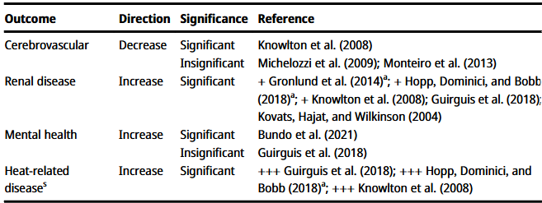
Findings: Morbidity (continued)
Heat leads to a significant increase in
Renal disease morbidity
Heat-related disease morbidity
Studies find inconclusive results for
Cerebrovascular morbidity
Mental health outcomes
Bundo et al. (2021): Mental health hospitalization data from 1973 - 2017 in Bern: Hospitalization risk increases linearly by 4% for every 10°C increase in mean daily temperature
Guirguis et al. (2018): Hospitalization data from 1999-2013 for three unique climate regions in San Diego: No significant relationship between mental health and temperatures for any region
Results for increases in morbidity not as clear as for mortality
Notes:
Guirguis:
used patient discharge (PD) data from the California Office of Statewide Health Planning and Development for acute care facilities to determine the impact of high ambient temperatures on hospital admissions in three distinct climate regions of San Diego County
Local daily maximum temperatures were collected
Total number of hospitalizations: Desert 4515, Inland 156633, Coastal 346042
Bundo
investigates the short-term association between ambient temperature and mental health hospitalizations in Bern
Daily hospitalizations for mental disorders between 1973 and 2017 were collected from the University Hospital of Psychiatry and Psychotherapy in Bern
study included a total number of 88,996 hospitalizations

Slide 7
Recommendations
Estimate comparison from heterogenous definitions
Developed regions (Europe)
Focus on mountainous and colder regions
Granular health data (PAN EU)
Appropriate research design
Confounded EWEs, NCDs (heat wildfire smoke respiratory)
Health forecast

Slide 8
THANK YOU
Prasanta Kumar Roy
Dr. Lea Bernhardt
Leonie Holst
Hamburg Institute of International Economics (HWWI)
Mönkedamm 9 | 20097 Hamburg | Germany
Tel.: +49 40 340576-0
Internet: www.hwwi.org
E-Mail: roy@hwwi.org, bernhardt@hwwi.org
Co-funded by the European Union. Views and opinions expressed are however those of the author(s) only and do not necessarily reflect those of the European Union or European Climate, Infrastructure and Environment Executive Agency (CINEA). Neither the European Union nor the granting authority can be held responsible for them.
Visit us: www.mountadapt.eu

Slide 9
Search string
( "climate change" OR "global warming" OR "pollution" ) AND
("human" OR "anthropogenic" ) AND
( "disaster" OR "heat wave" OR "heatwave" OR "hurricane" OR "wildfire" OR "flood" OR "drought" OR "storm" OR "heavy rain" OR "catastrophe" OR "cyclone" ) AND
("dissatisfaction" OR "hospitalization" OR "cardiovascular" OR "respiratory" OR "mental health" OR "ncd" OR "non-communicable" OR "psychological" OR "depression" OR "stress" OR "anxiety")

Slide 10
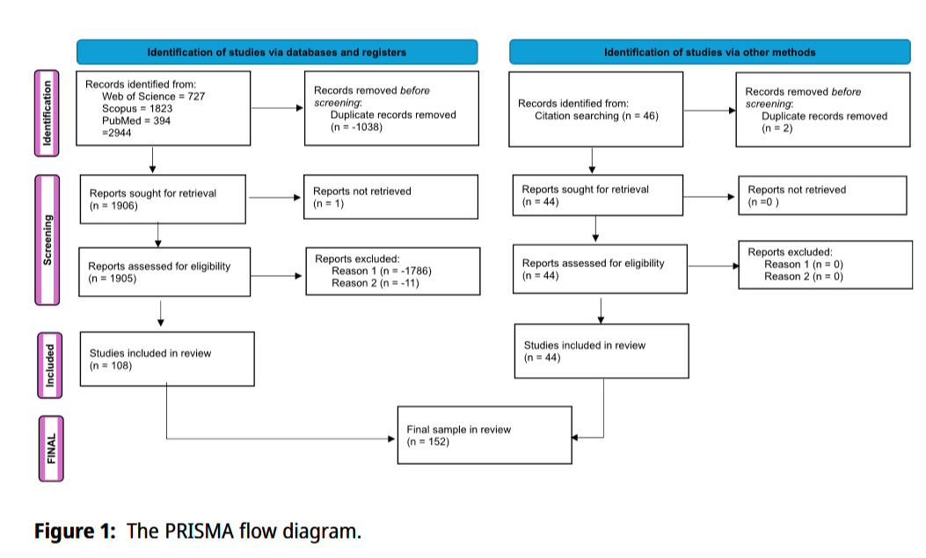
PRISMA Flow Diagram

Slide 11
Agenda
Literature review
Findings on mortality of NCDs due to heat
Findings on morbidity of NCDs due to heat

