Slide 1
Preventing health effects from heat
in the
WHO European Region
Bonn, Germany
20 February 2025
Marisol Yglesias-Gonzalez
Technical Officer, Water and Climate
WHO European Centre for Environment and Health

Slide 2
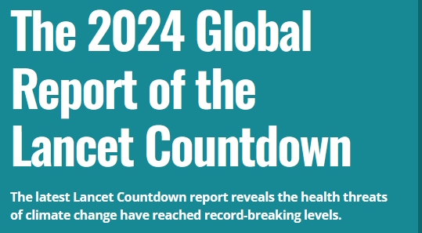
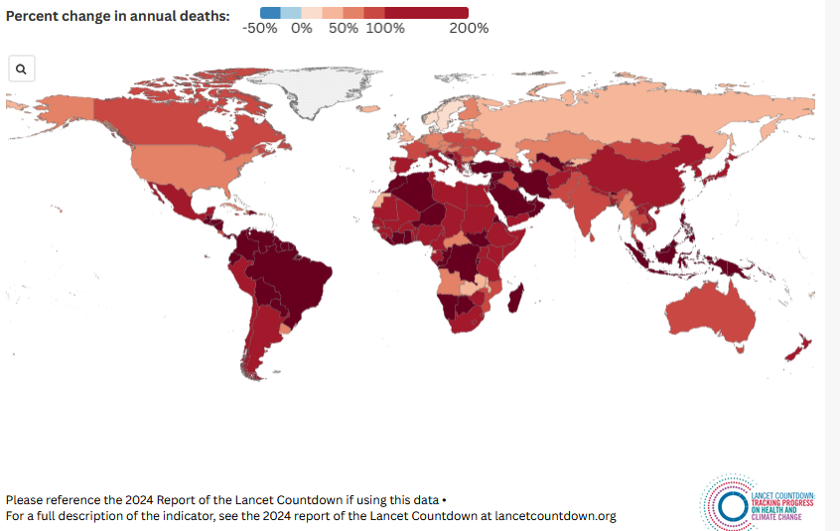

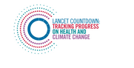
HEALTH THREATENING HIGH TEMPERATURES

Slide 3
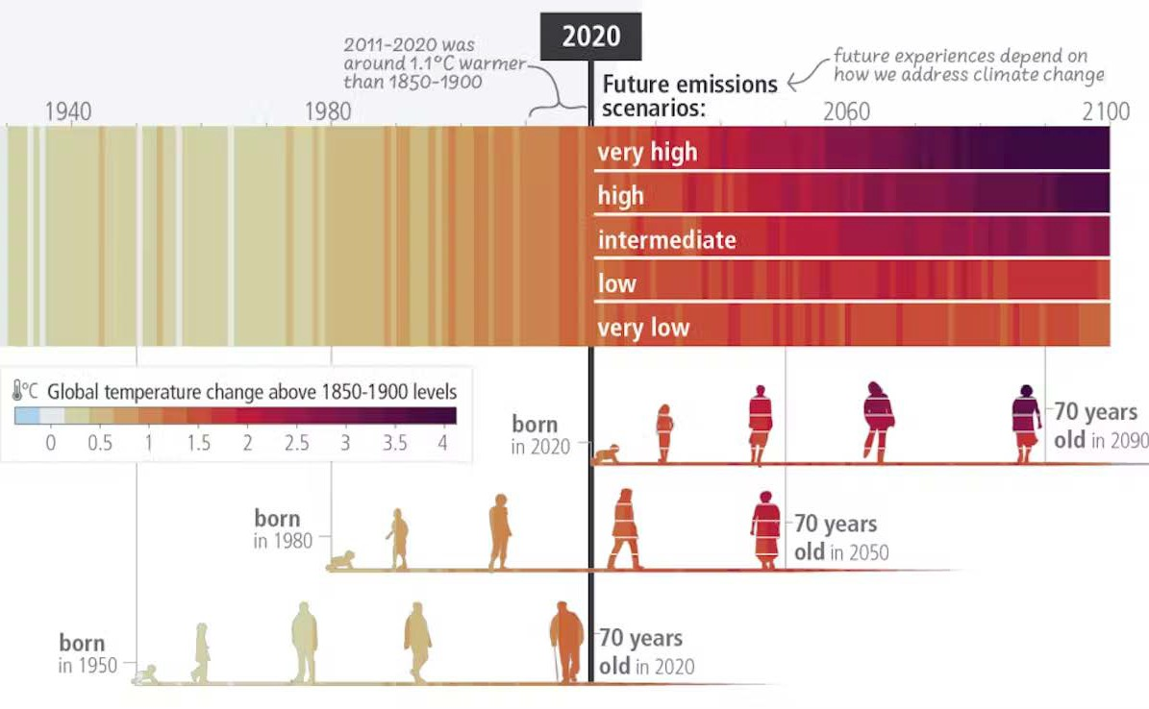


HIGHER, FURTHER, HOTTER
Climate change is projected to significantly increase population exposure to heat-related morbidity and mortality.
(HIGH CONFIDENCE)
Heat is a growing health risk due to burgeoning urbanization.
(VERY HIGH CONFIDENCE)
Strong geographical differences in heat-related mortality are projected to emerge later this century.
(VERY HIGH CONFIDENCE)
European temperature increases more than 2x the global average and is projected to increase by +2.5°C to +7°C by 2100

Slide 4
IN THE WHO EUROPEAN REGION
The three warmest years have all occurred since 2020
2023 reached a record number of days with ‘extreme heat stress’
19 of the 23 most severe heatwaves in Europe since 1950 occurred since 2000, and four in the last three years
Person-days of heatwave exposure increased by 97% in the last decade
Heat-related deaths increased on average to 17.2 per 100,000 inhabitants in the last decade
2022 heat killed 60,000+ Europeans
2023 heat killed 47,000+ Europeans

Slide 5
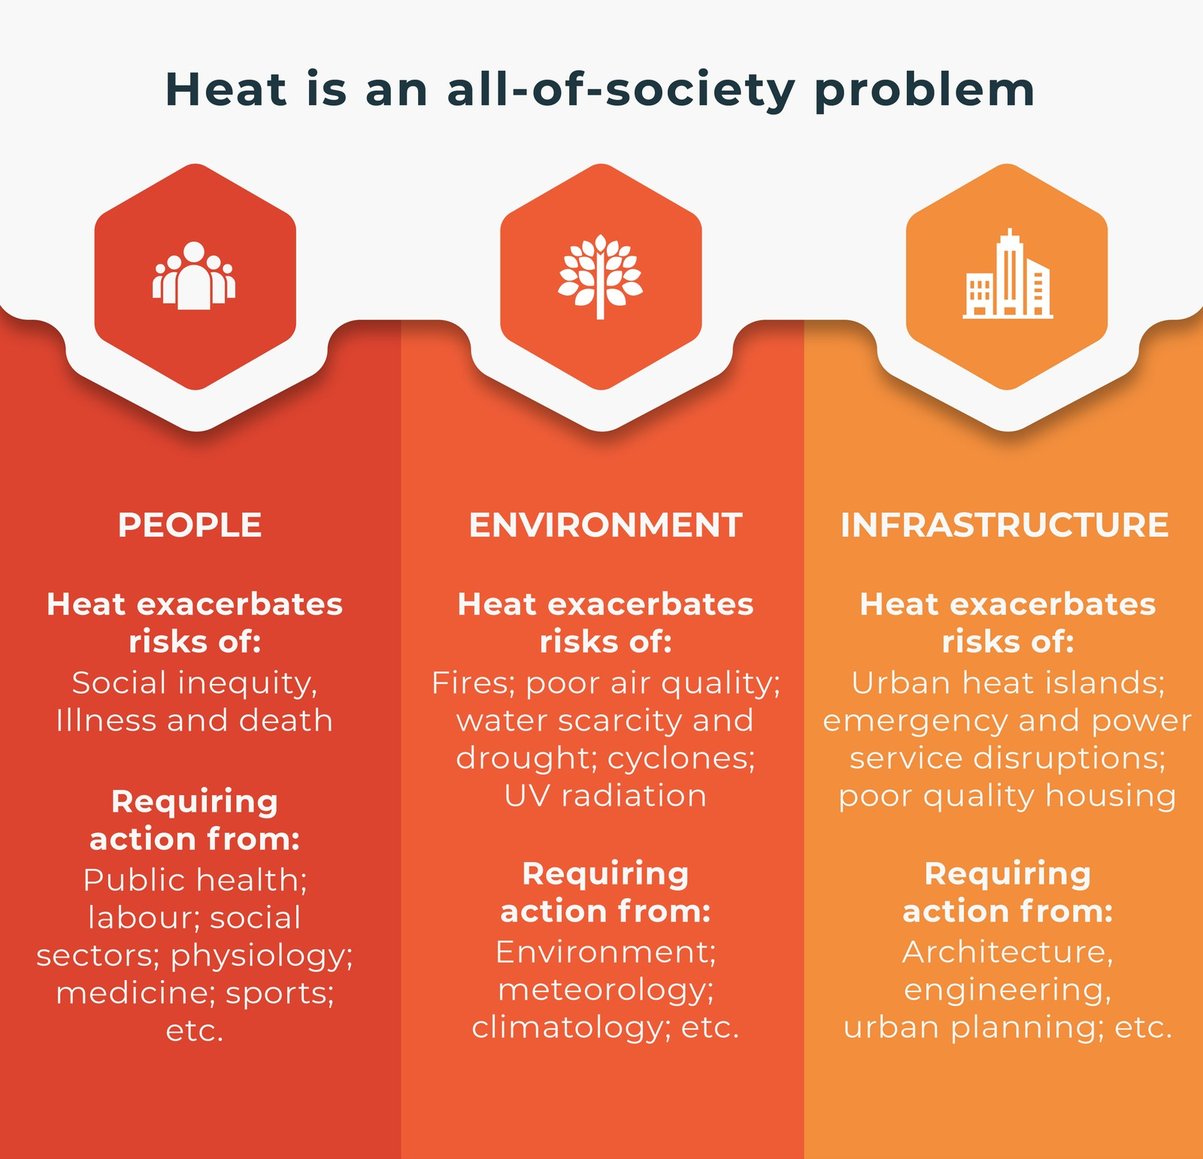
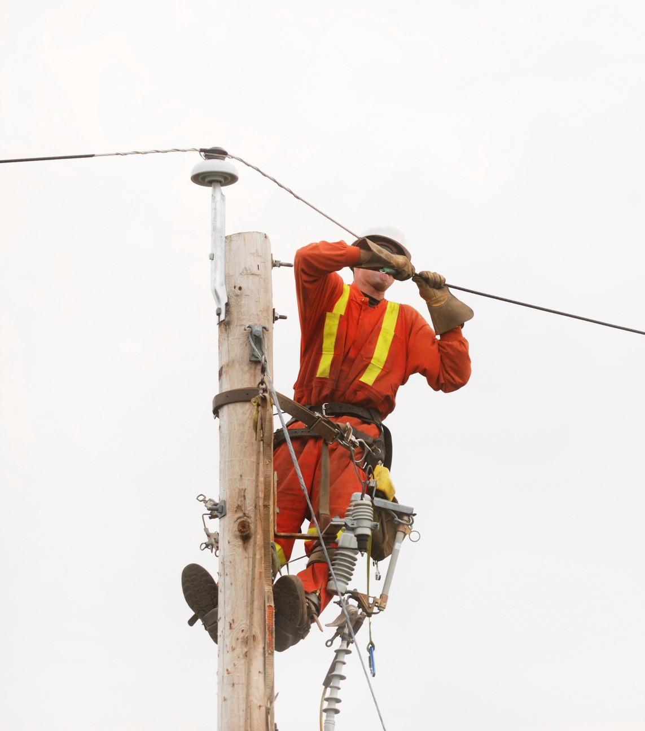
HEAT IS AN ALL-OF-SOCIETY PROBLEM

Slide 6
MANDATE IN WHO/EUROPE

Slide 7
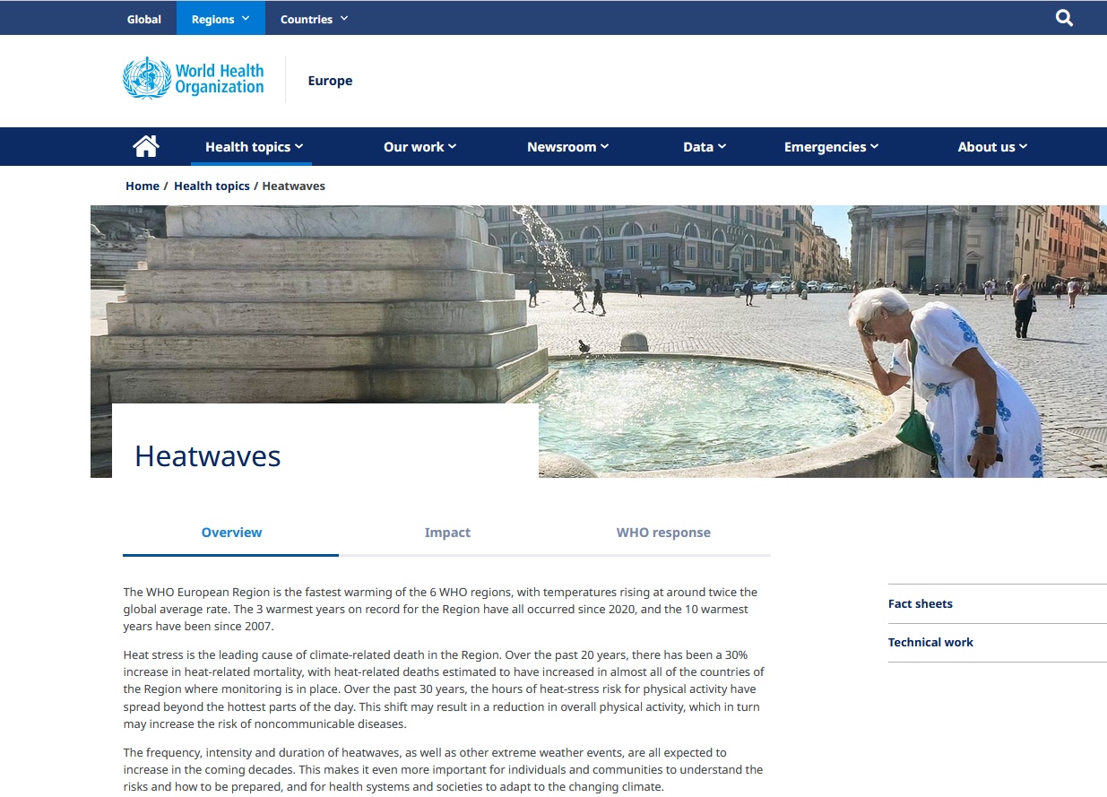
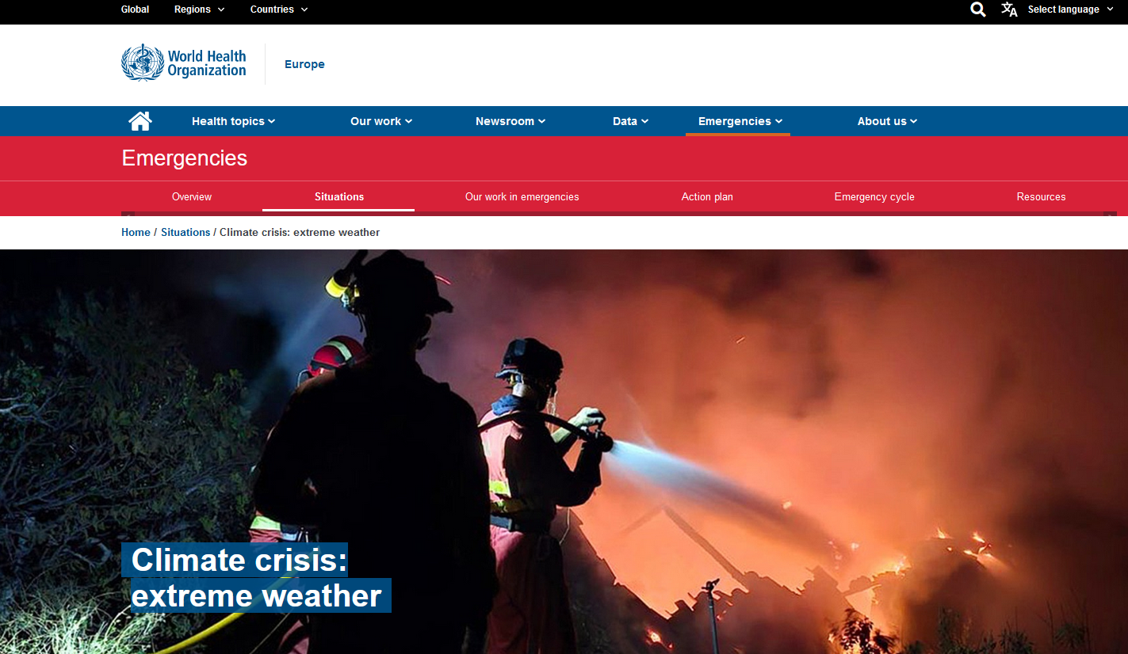
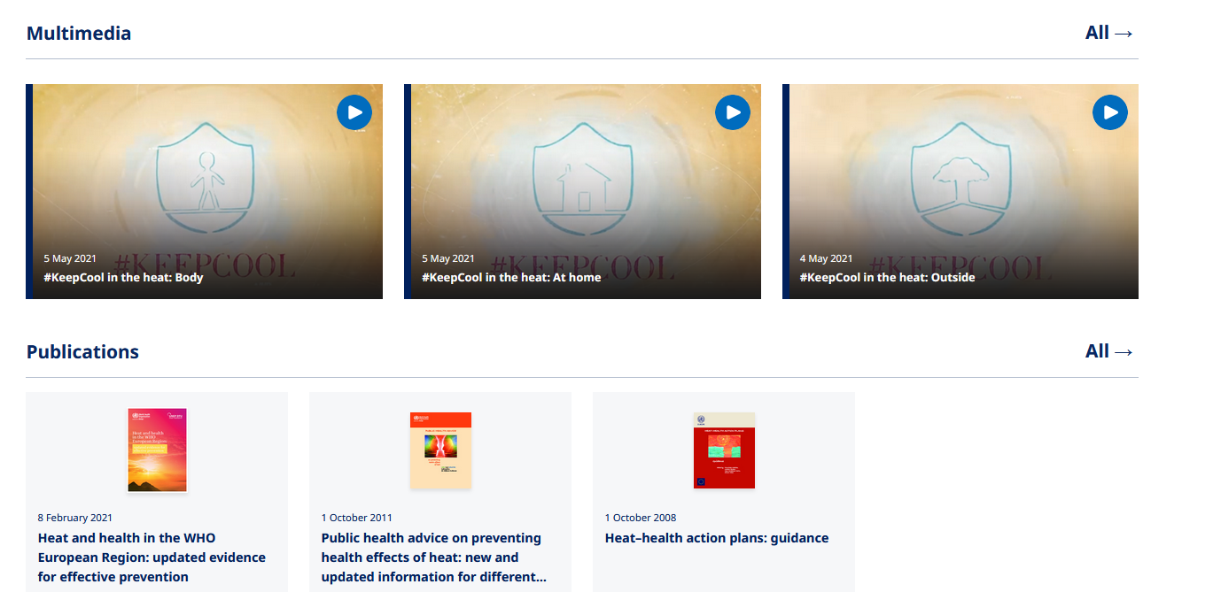
PUBLIC HEALTH EMERGENCY

Slide 8
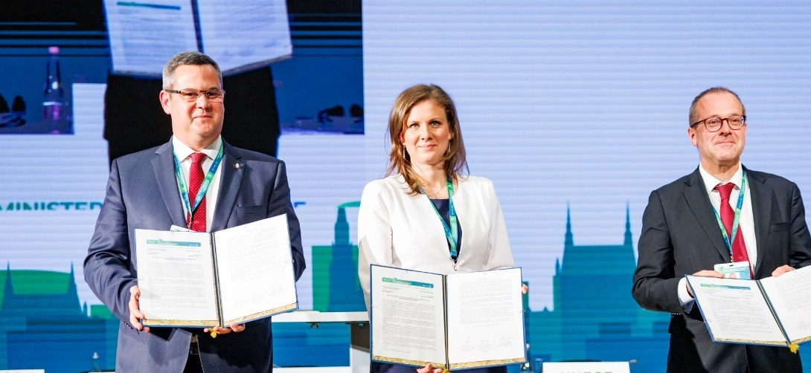
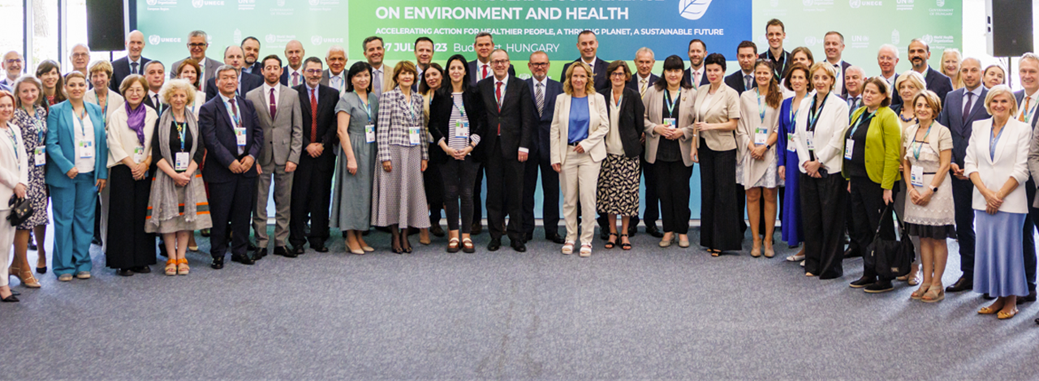
7th MINISTERIAL CONFERENCE ON ENV. & HEALTH
(Budapest, 5–7 July 2023)
Tackle climate change, environmental pollution and loss of biodiversity
Build forward better from COVID-19, including actions for urban resilience
Protect vulnerable populations and vulnerable life stages

Slide 9
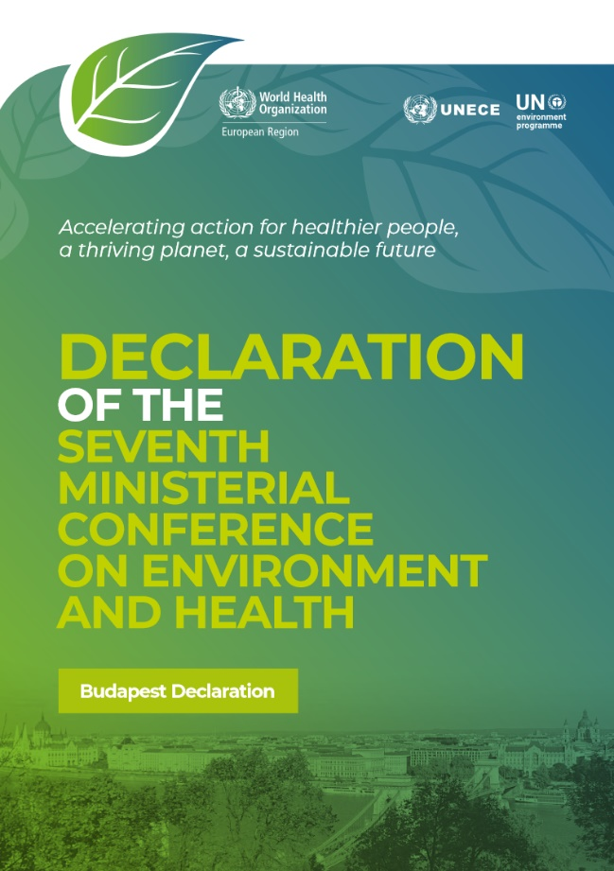
CLIMATE & HEALTH IN THE BUDAPEST DECLARATION
Making health systems and facilities climate-resilient, environmentally sustainable, and decarbonized
Establishing health-centred targets in national planning, in
particular in the National Determined Contributions
Developing, updating, and implementing Health National
Adaptation Plans
Developing and updating heat-health action plans
Establishing requirements to ensure the climate resilience of
water and sanitation services
Strengthening natural disaster risk reduction policies and climate-informed health early-warning and surveillance systems
Strengthening the climate-literacy of health professionals

Slide 10
HHAP GUIDANCE UPDATE

Slide 11
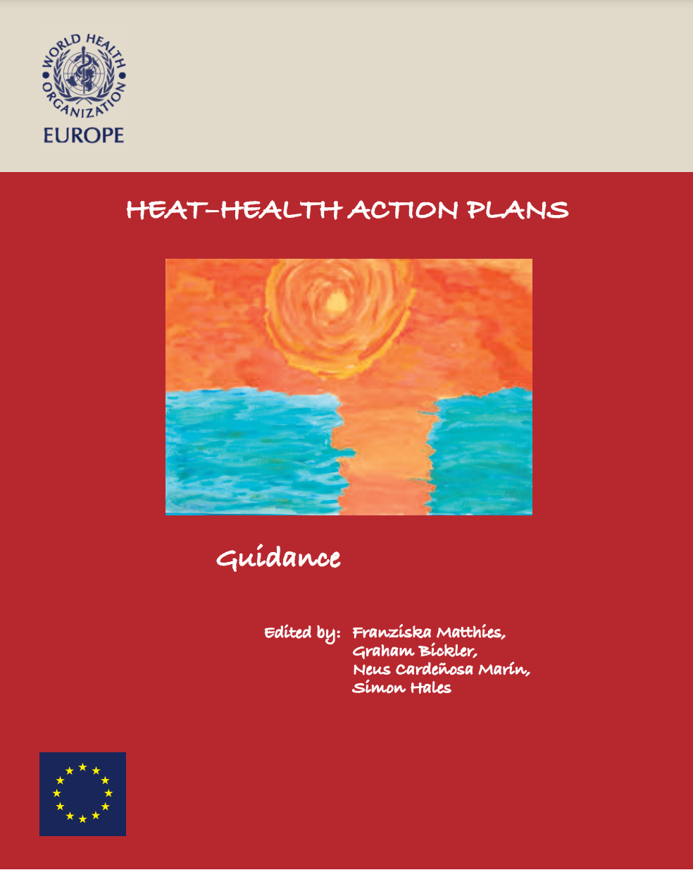
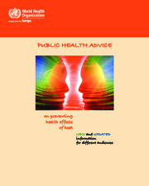
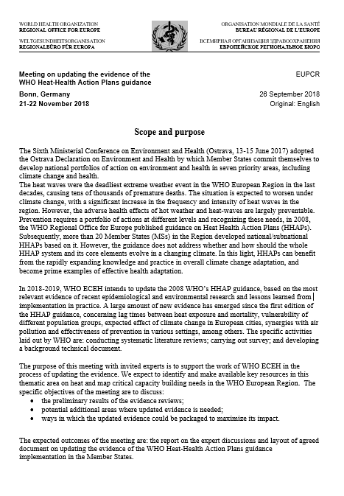
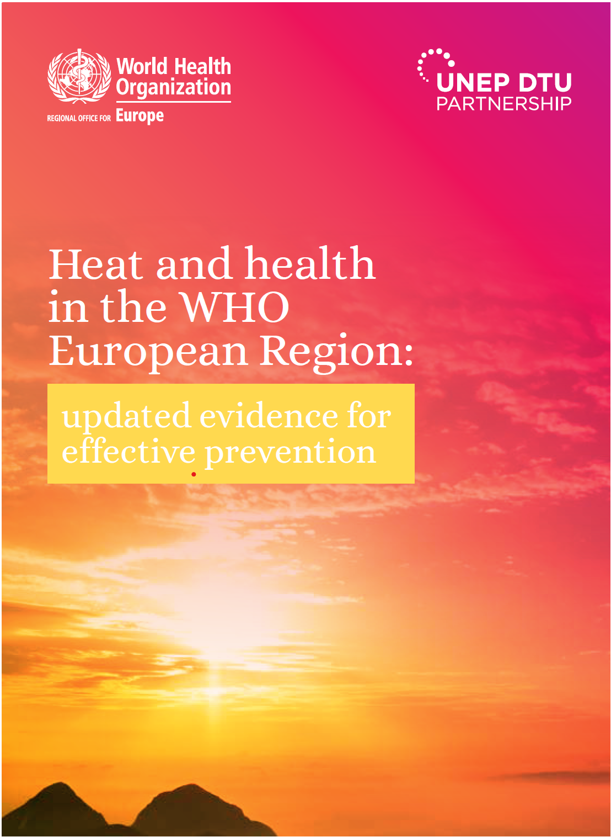
HHAP PROCESS IN WHO/EUROPE
WHO Heat–Health Action Plans Guidance
Second edition
2008
2011
2018
2021
2023-2025

Slide 12
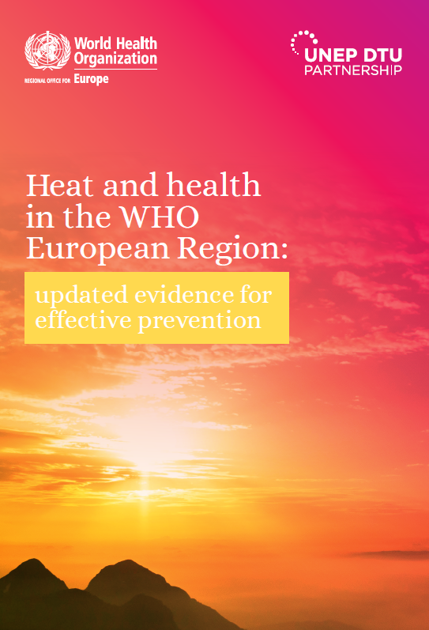
EVIDENCE REVIEW
  Most comprehensive evidence review on HHAPs to date
  Over 600 scientific sources, both conventional peer-reviewed and governmental
  Expert group-steered, fully peer-reviewed
  Comprehensive WHO/Europe national and local HHAP country survey
  Organized around the 8 core elements of the WHO 2008 HHAP guidance

Slide 13
EVIDENCE REVIEW
Countries with HHAP
Implementations of core elements
Austria
Belgium
Croatia
France
Germany
Hungary
Italy
Lithuania
Luxembourg
Malta
Netherlands
North Macedonia
Portugal
Spain
Sweden
Switzerland
Tajikistan
Turkmenistan
United Kingdom
Martinez, G. S., Kendrovski, V., Salazar, M. A., de’Donato, F., & Boeckmann, M. (2022). Heat-health action planning in the WHO European Region: Status and policy implications. Environmental Research, 214, 113709. https://doi.org/10.1016/j.envres.2022.113709

Slide 14
UPDATED CORE ELEMENTS
GOVERNANCE
HEAT-HEALTH
WARNING SYSTEM
VULNERABLE
POPULATIONS
COMMUNICATIONS
ESTABLISH A GOVERNANCE
STRUCTURE FOR HEAT-HEALTH
ACTION
IMPLEMENT AN ACCURATE AND TIMELY WARNING SYSTEM FOR ACTION
ENSURE CARE FOR THOSE AT RISK
DEVELOP A HEAT-HEALTH
COMMUNICATIONS PLAN
HEALTH SYSTEM
RESILIENCE
REDUCTION IN HEAT
EXPOSURE
SURVEILLANCE
MONITORING,
EVALUATION
AND LEARNING
ESTABLISH TIMELY SURVEILLANCE
AND DETECTION
FOR HEAT-HEALTH
ACTION
STRENGTHEN HEALTH SYSTEM
PREPAREDNESS AND RESPONSE
PROTECT PEOPLE FROM HEAT.
ESTABLISH A PROCESS FOR REVIEW AND IMPROVEMENT

Slide 15
EXAMPLES

Slide 16
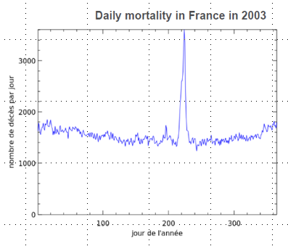
THE HEAT PREVENTION PLAN
Santé publique France
The shock of August 2003 in France
~15,000 excess deaths in ~ two weeks
The lack of coordination and information sharing was a major obstacle to public response during the 2003 heatwave
2004: National heat prevention plan and warning system
Multiple actors and actions to anticipate, to warn, to protect
In 2024, 10 ministries were involved in the heat prevention plan (Health, Environment, Security, Economy, Agriculture, Sports, Labour, Education, Culture, Justice)
Warning system → Collaboration between Météo-France, Santé publique France, and the Ministry of Health
Notes:
Graph: Daily mortality in France in 2003
(Graph shows a spike in mortality around the middle of the year)
X-axis: Jour de l'année (Day of the year)
Y-axis: Nombre de décès par jour (Number of deaths per day)

Slide 17
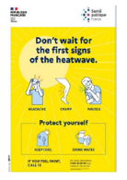
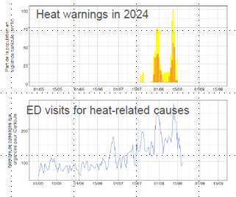
HEALTH DATA IN THE HEAT HEALTH WARNING SYSTEM
Before: Epidemiological studies to choose evidence-based warning thresholds
Warning decisions are based on temperature forecasts
During: Near-real-time surveillance system to support decision-making
Syndromic surveillance system collecting and monitoring mortality and morbidity impacts (1-day delay)
Mortality data from a sample of municipalities (15-day delay to obtain interpretable trends)
Trends in morbidity do not predict trends in mortality
After: Impact assessments, analyses of risk factors, evaluation of the efficiency of interventions
Mortality and morbidity impacts
Risk perception, communication.
Notes:
Graph:
Heat warnings in 2024 (indicating spikes in warnings)
Graph: ED visits for heat-related causes (showing an increasing trend over time)
Infographic: "Don't wait for the first signs of the heatwave" with protective measures (hydrate, cover, avoid sun exposure, etc.)

Slide 18
LESSONS LEARNT
A warning system needs to be robust and adaptable
Rapidly evolving situations, multiple exposures
Requires good communication between actors throughout the year
The system must work even if it is 50°C and the computers are breaking down
Warning based on temperature forecasts are efficient and sufficient
Because prevention actions are costly, some people may want to wait for the observation of a health impact to act → but then it is too late!
Collective expertise is key to decision-making → during heat waves, we can have several meetings per day with Météo-France and the Ministry of Health
Communication before, during, and after summer is essential to maintain awareness and the willingness to act
Risk perception is still low
Warning fatigue is a real problem

Slide 19

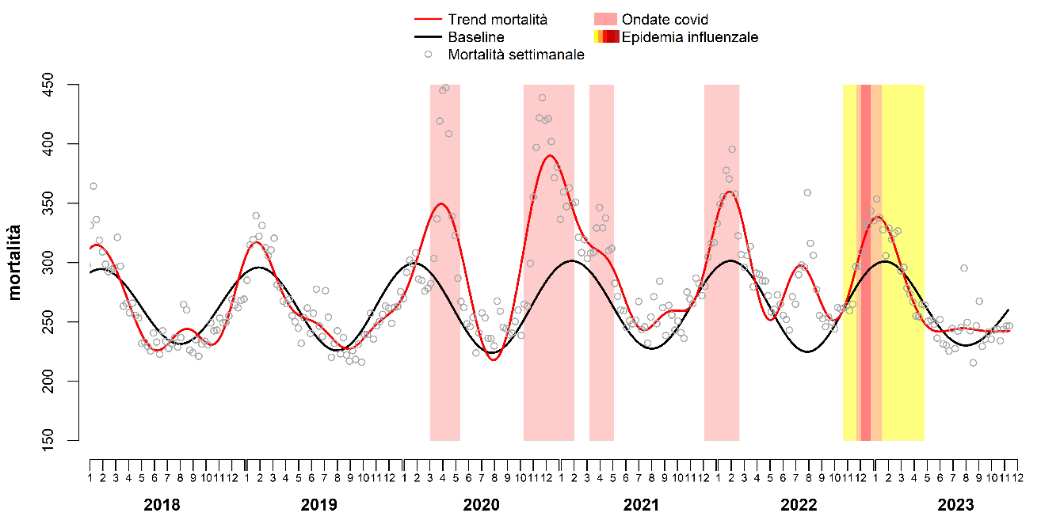

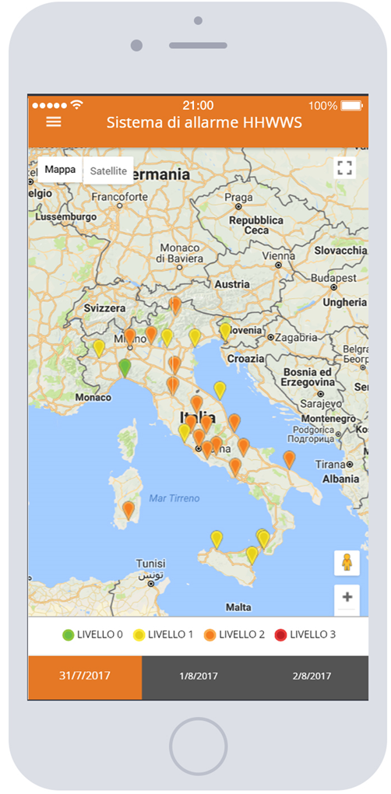
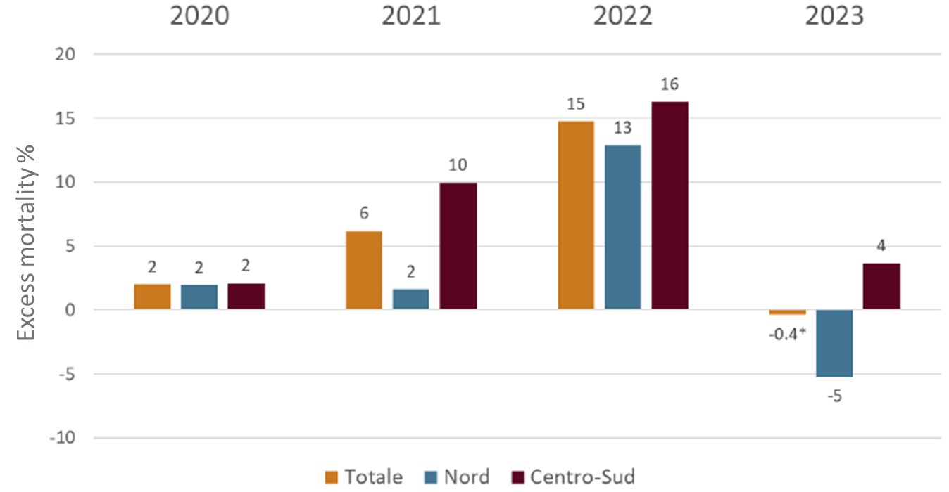
ITALIAN HEAT HEALTH ADAPTATION PLAN
MONITORING AND
WARNING SYSTEM
EPIDEMIOLOGICAL
SURVEILLANCE
COMMUNICATION
Heat warning system
Daily mortality
surveillance system
Summer 2023
information campaign
National APP
“Caldo e Salute”
27 city-specific
warning systems
3-day forecast warning bulletin
largely disseminated
Targeted national/regional/local campaigns
(web, TV, social, testimonial, etc.)
Prevention measures modulated according to the level of warning
Notes:
Summer 2020-23. Excess mortality elderly (65+ years) by year (Italy overall, northern and central-southern cities)

Slide 20
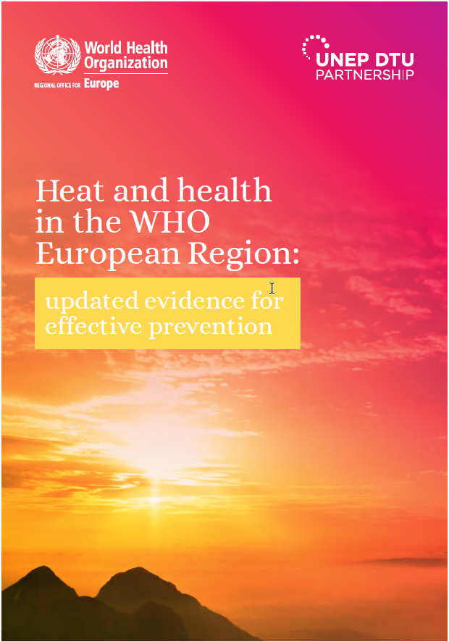

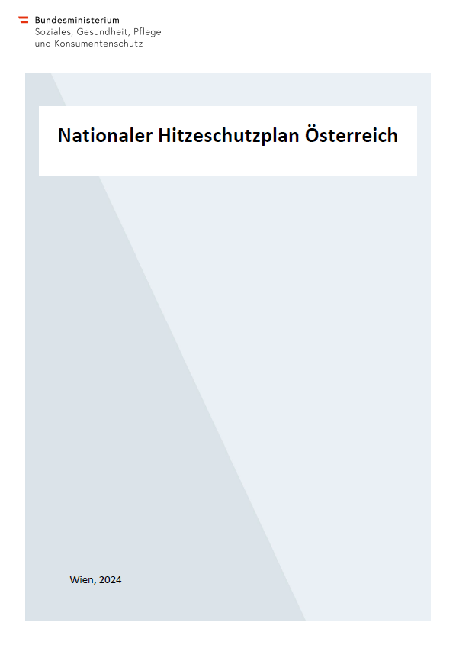
REVISION OF THE AUSTRIAN
HEAT PROTECTION PLAN
Working group
Press conference 19th June 2024
Advisory board
NATIONAL

Slide 21
National Heat Protection Plan | Modular design based on WHO recommendations
Introduction
National Heat Warning System
Information
and Communication
Heat protection for vulnerable population groups
Heat protection in health and social care settings
Monitoring of health impacts of heat
Appendix
Further information on
Health effects of heat
Communication of heat-related health information
Innovative warning systems

Slide 22
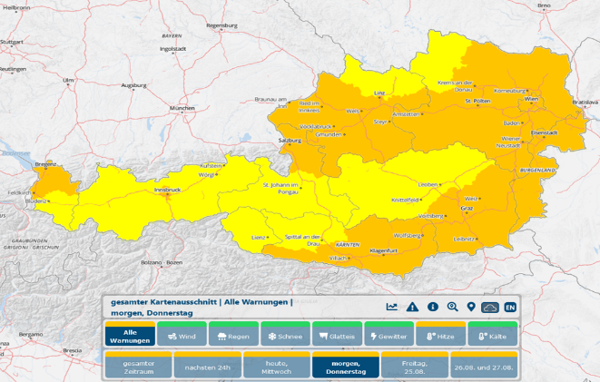

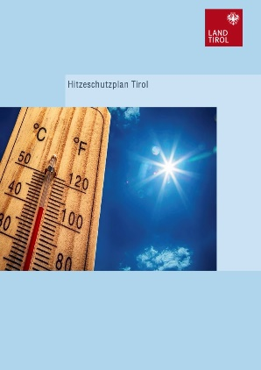


HEAT WARNING SYSTEM AND DISSEMINATION
GeoSphere Austria
24.8.2023
Weather forecast
Heat warning system
Ministry of Health
Heat phone
Social media campaign
Information via health portal
Federal states
Specific heat action/protection plans

Slide 23

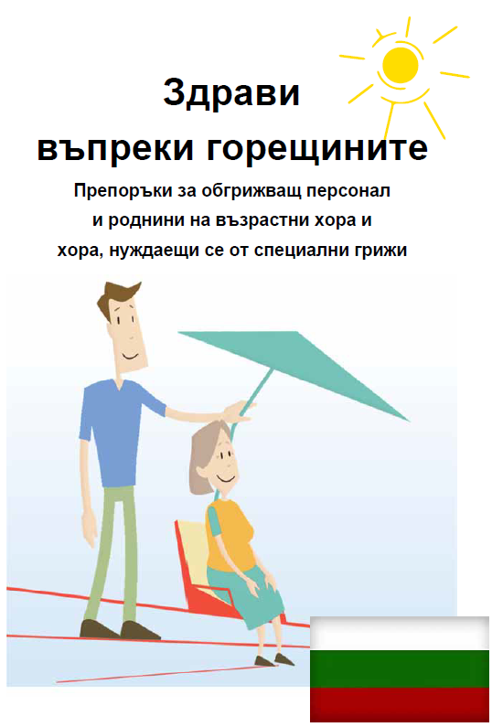
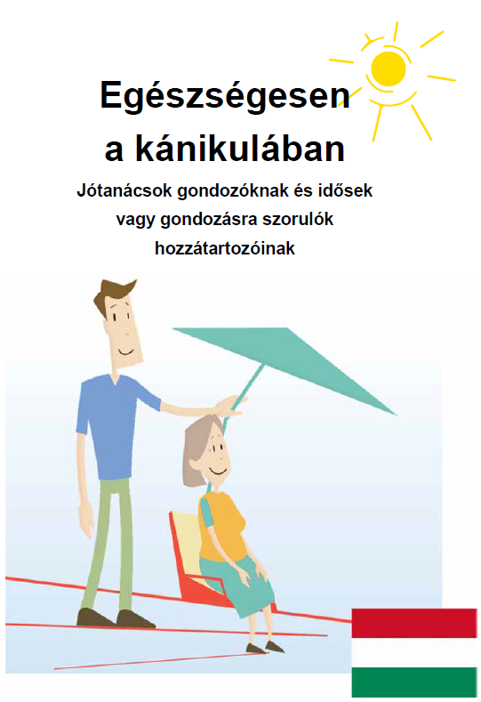
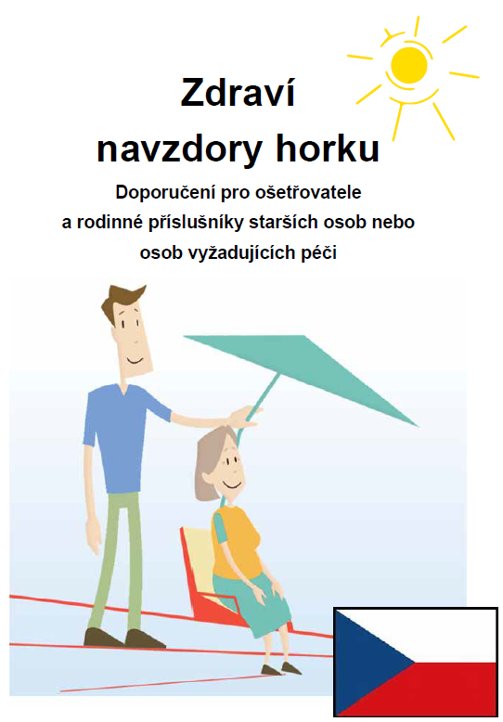
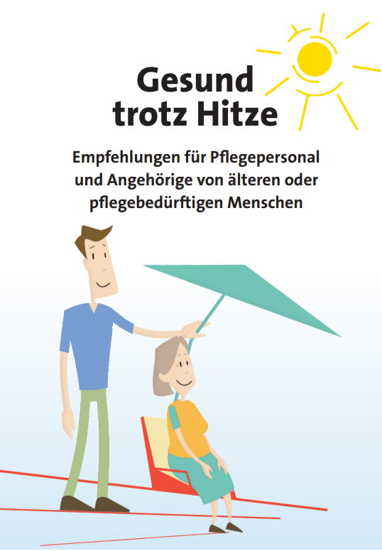
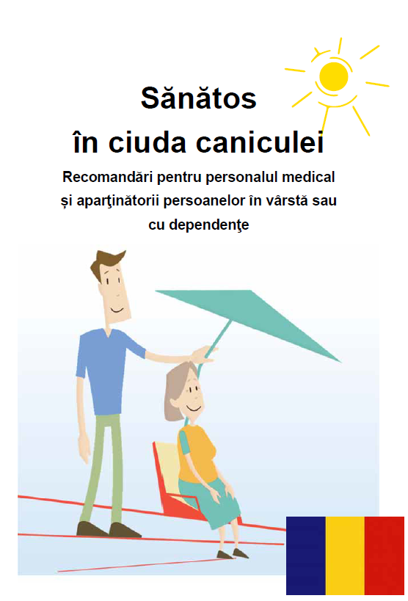

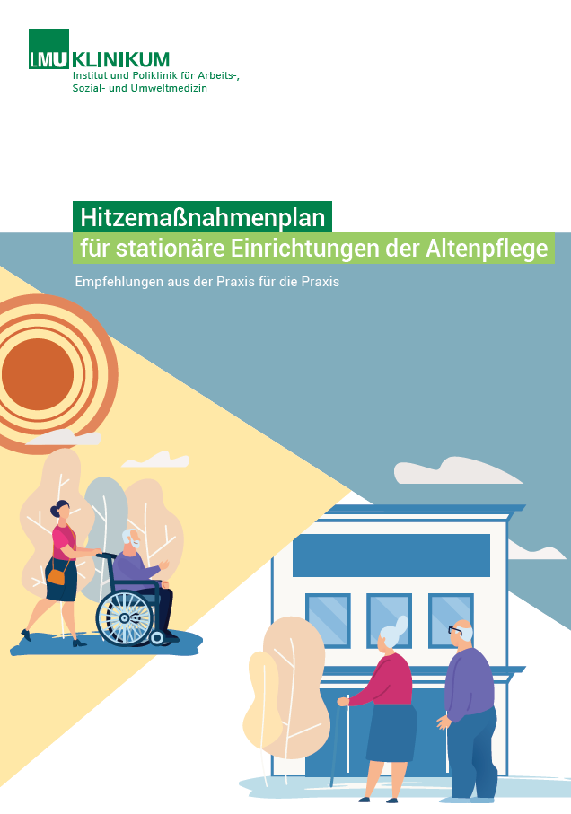
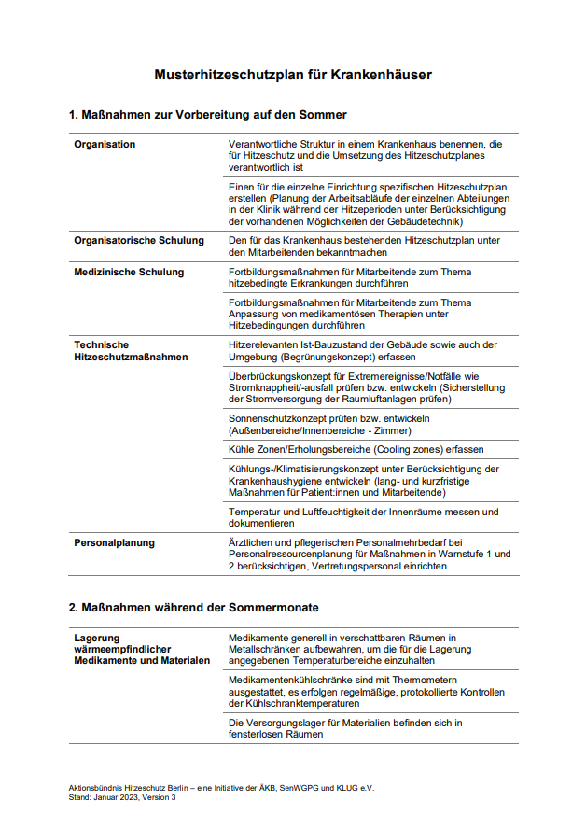
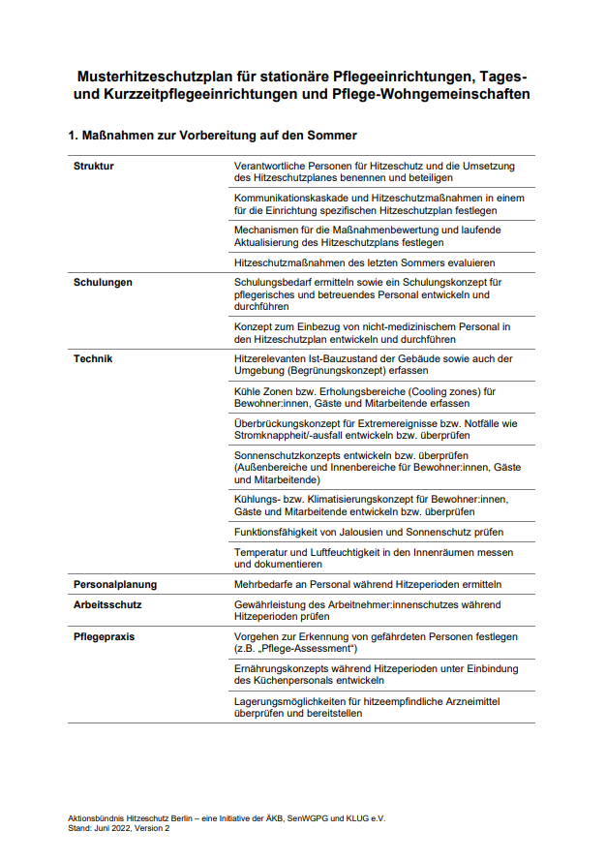
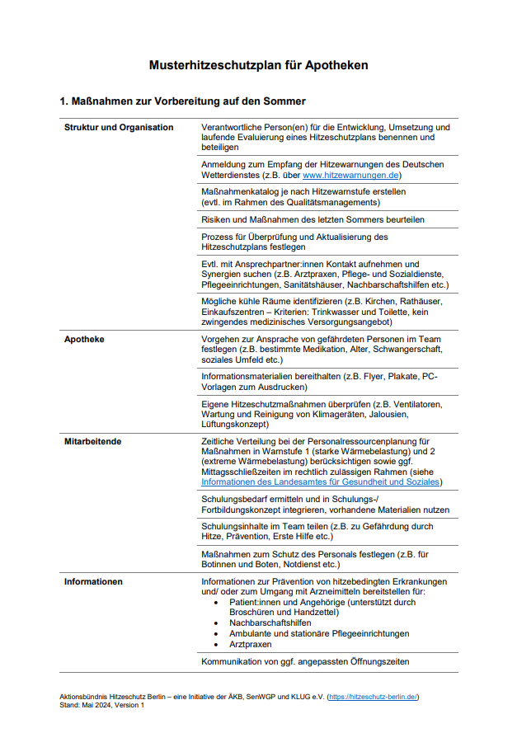
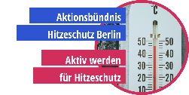
ADDRESSING VULNERABLE POPULATION GROUPS &
HEALTH AND SOCIAL CARE SETTINGS
Toolbox for accessibility and support for vulnerable population groups with best practices examples
Lists of possible measures at local and/or regional level in cases of heat and heat-related stress for vulnerable population groups
List of recommended measures to prepare for, protect against and respond to heat and heat-related stress in health and social care settings
Toolbox for heat protection plans for health and social care settings with best practices examples

Slide 24
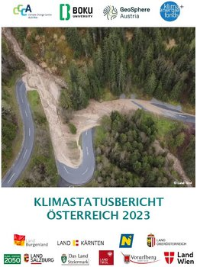

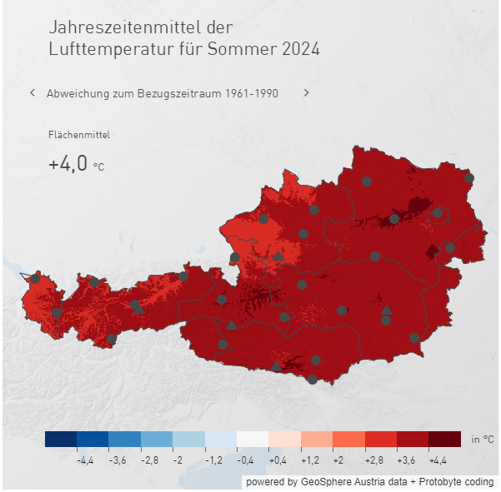
MONITORING THE IMPACT OF HEAT ON HEALTH
Heat mortality monitoring
  Estimate of heat-associated excess mortality including 95 % confidence
  interval, Austria, summer periods
Heat morbidity monitoring
  Hospital admissions based on selected ICD-10 codes
Toolbox for meteorological
parameters and climate overviews

Slide 25
Thanks
Marisol YGLESIAS GONZALEZ | Technical Officer (Climate Change Adaptation and Health)
WHO Regional Office for Europe | European Centre for Environment and Health |
Bonn, Germany
yglesiasgonzalezm@who.int

